Slide 1
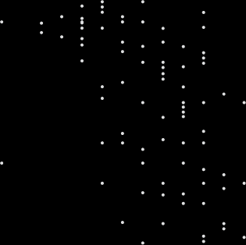


Data Visualization Workshop
Davis Data Science Club
ggplot2
matplotlib
seaborn

Slide 2

Project Lead Applications
Apply to become a project lead in Spring quarter!
Open to students of all majors, backgrounds, and years
A few short questions + project proposal + resume
Deadline: Sunday, March 24th @ 11:59pm
tinyurl.com/DDSCLeadSpring2024
Notes:
Aditya
Note: Emphasize checking pre-req for DataLab workshop

Slide 3
Upcoming Events
Wednesday, March 6th @ 6:30-8pm: Winter Project Presentation
Pizza and snacks provided!
Wednesday, March 13th @ 7-8pm: Open Study Session
No formal meeting - feel free to meet up with friends to study for finals
Sunday, March 24th @ 11:59pm: Project Lead Apps due!
Keep an eye out for officer applications too :)
Notes:
Aditya
Note: Emphasize checking pre-req for DataLab workshop

Slide 4
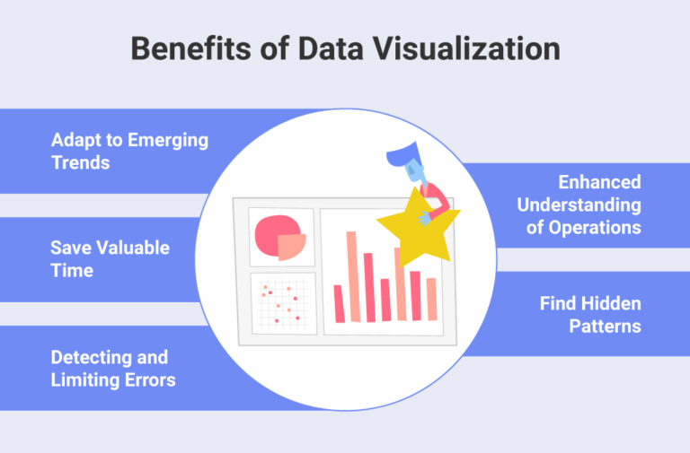
So what is it and why do we need it?
Pretty self explanatory - representing data visually!
Charts, graphs, and maps
Data visualization provides an accessible way to see and understand trends, outliers, and patterns in data
Beneficial for sharing with people who do not know the data very well or are not well-versed with analyzing or interpreting data

Slide 5
Good visualizations!

Slide 6
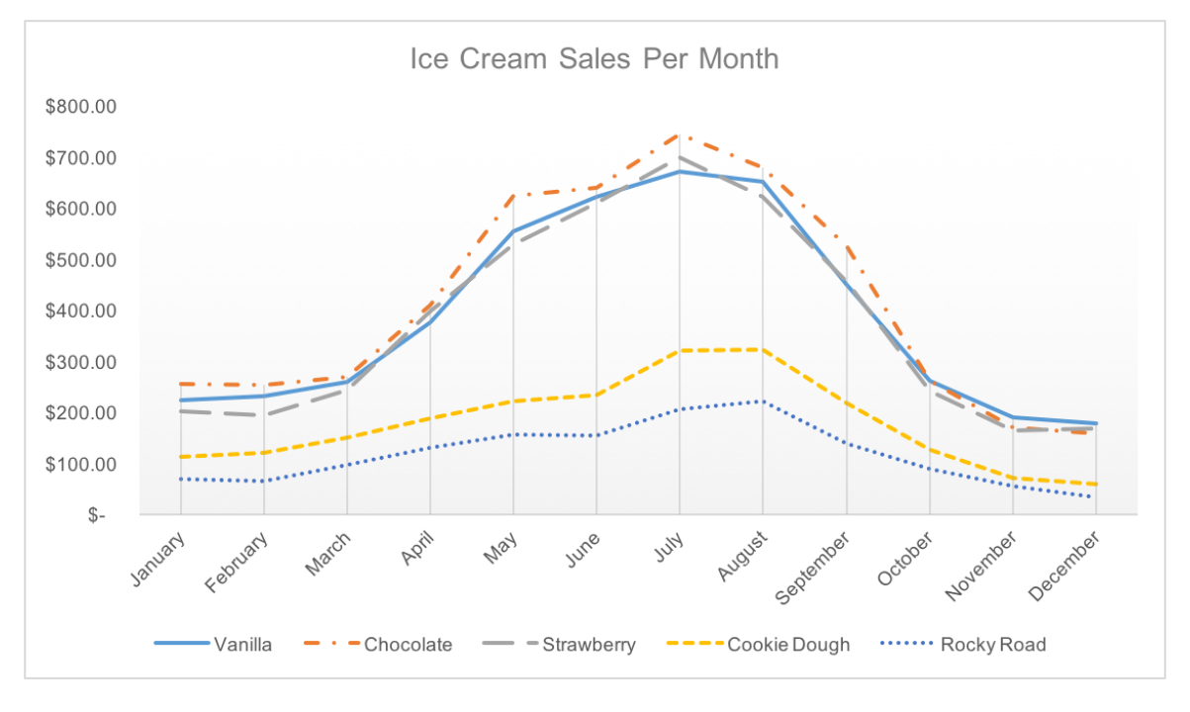
Source

Slide 7
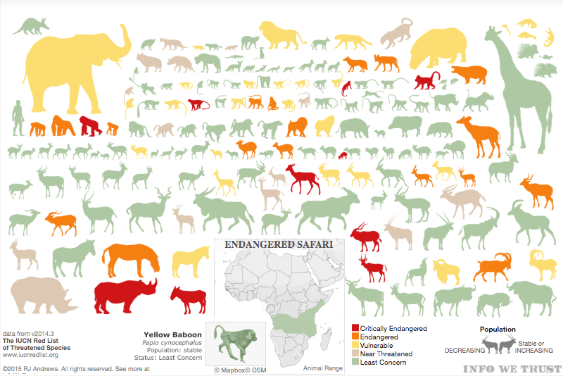
Source

Slide 8
Not so good visualizations

Slide 9
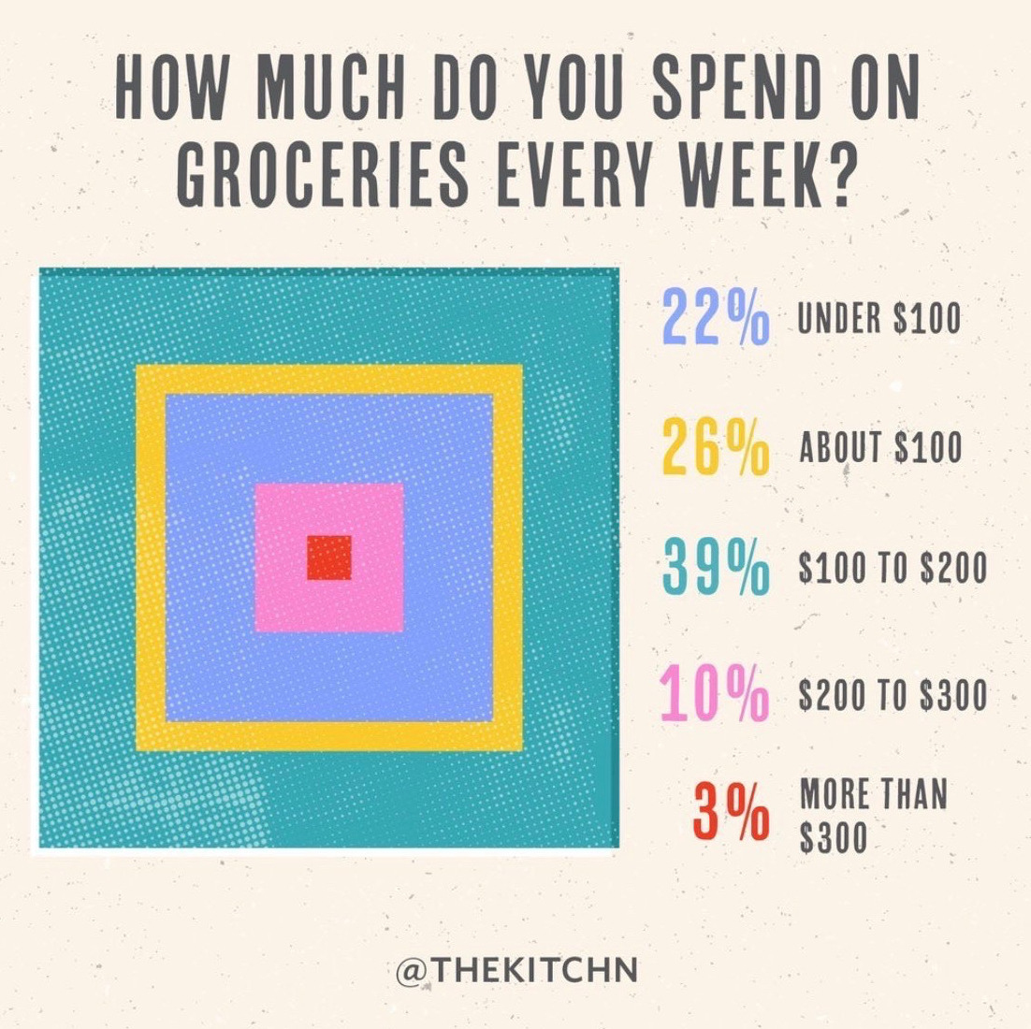
Source

Slide 10
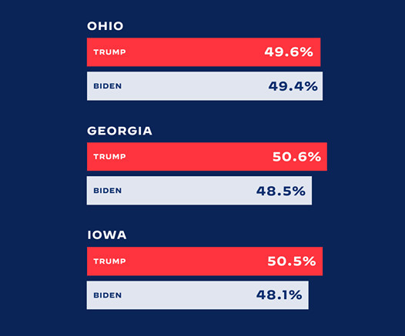
Source

Slide 11
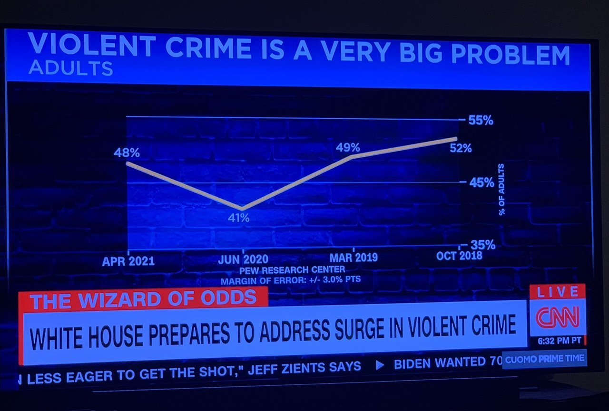
Source

Slide 12
What makes a good visualization?

Slide 13
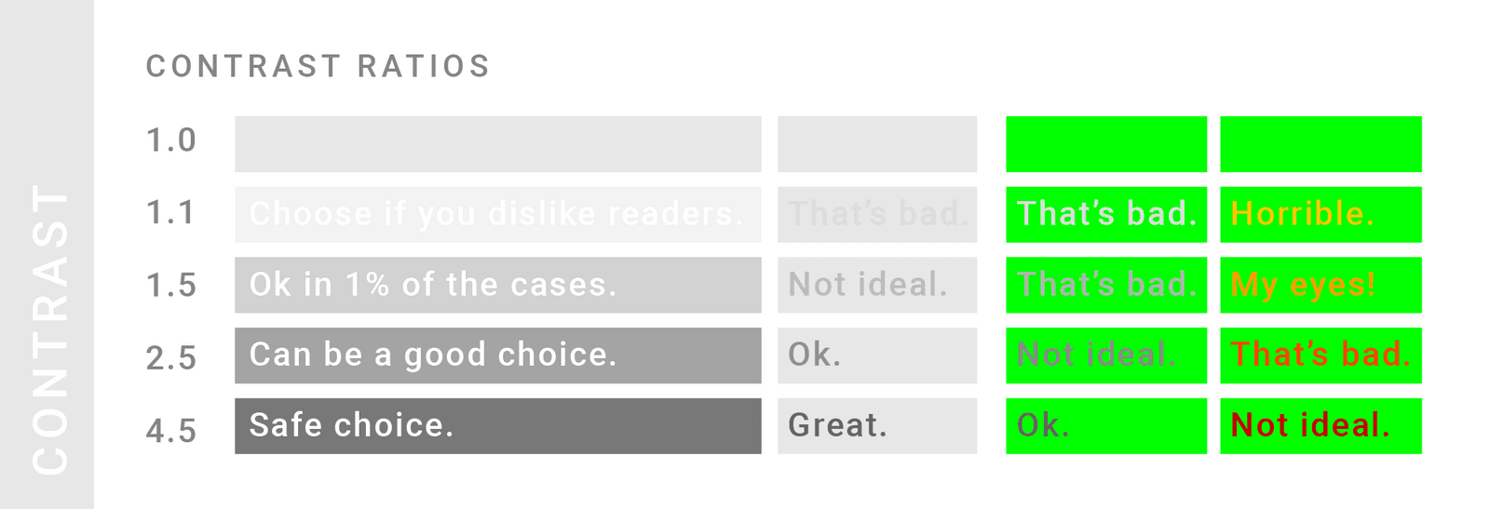
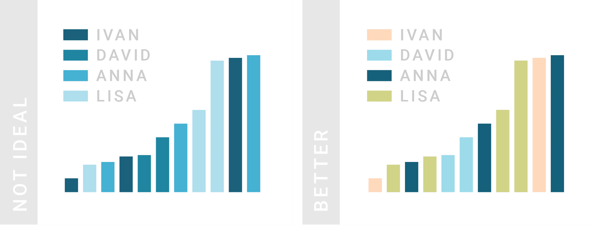
Source

Slide 14
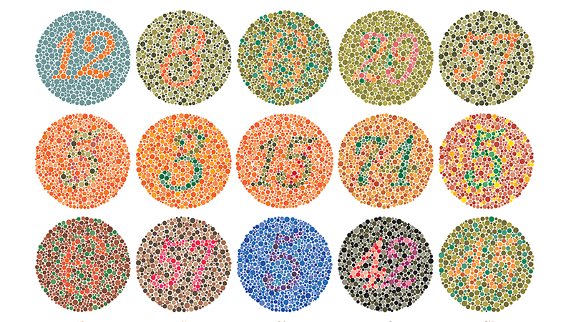
Source

Slide 15
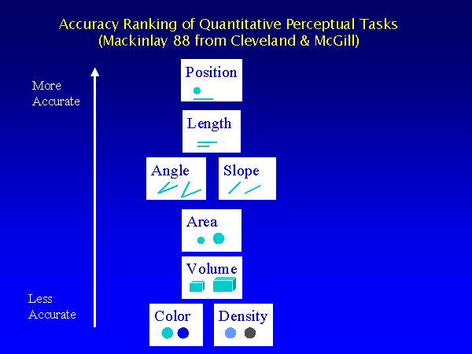
Source

Slide 16
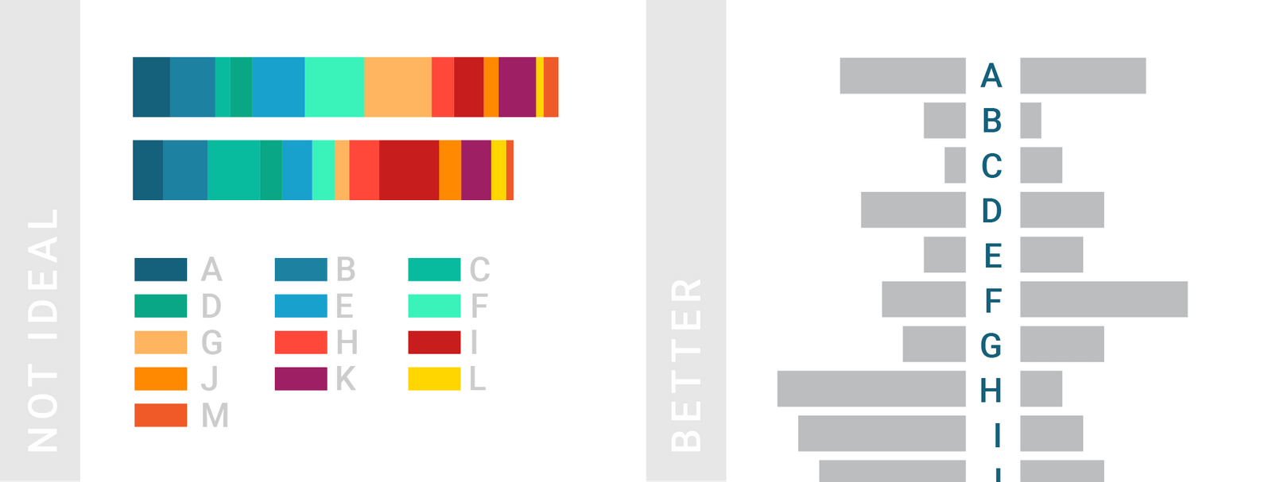
Source

Slide 17
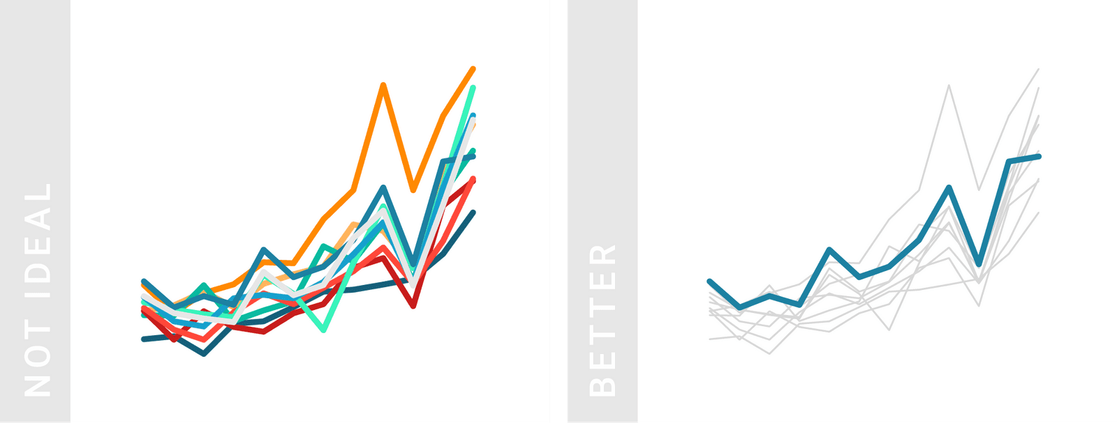
Source

Slide 18
General tips/thought process
What story do I want to tell?
Why am I making this? Who is seeing this?
Which kind of plot/visuals will best portray my story?
How am I going to make this visualization?
Have a purpose
Be honest
Simple is better, only use as much as you need to express your point
Get rid of anything that clutters your story
Make good design choices so it’s easy to read and understand

Slide 19
Types of visualizations!

Slide 20
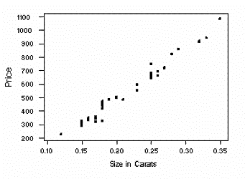
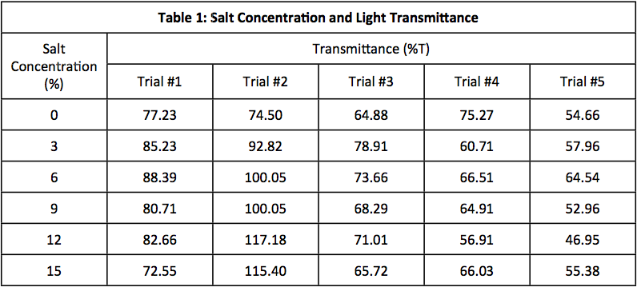
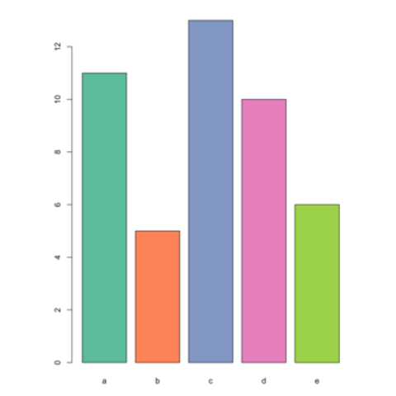
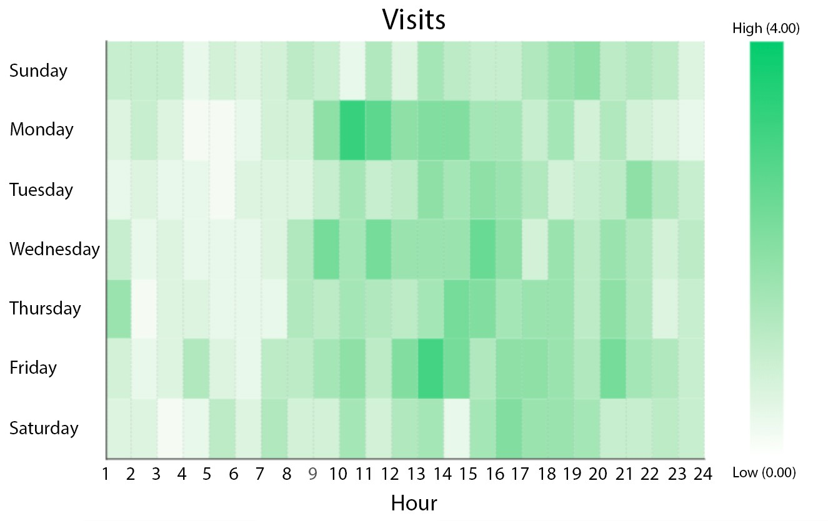
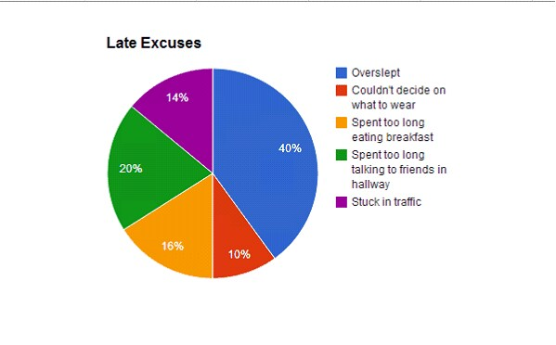
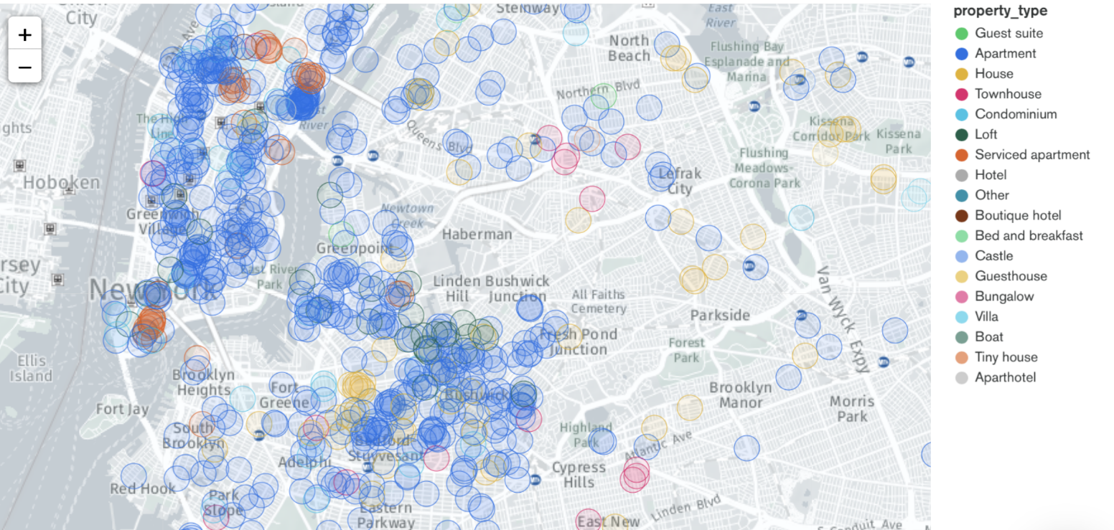
Tables
Scatterplots
Bar plots
Line plots
Heat maps
Geospatial
Pie charts
Dashboards
Many more!

Slide 21

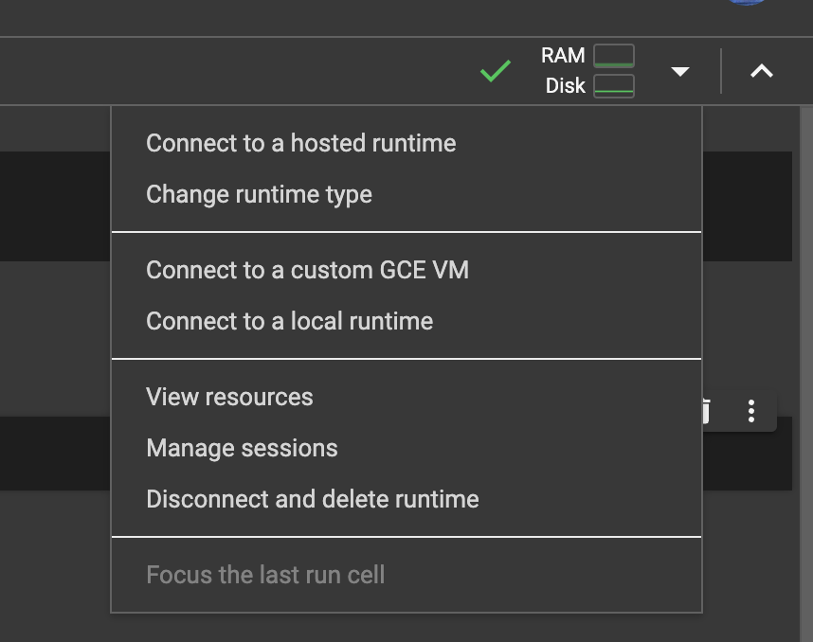
Google Colab
Google Colab: https://colab.google/
Default language should be Python3
To change to R:
Go to the down arrow next to RAM and Disk
Click on change runtime type
Then select R
Link to notebook to follow along: http://tinyurl.com/kbk7a5px
(Need to make a copy if you want to save it)
Notes:
Change run

Slide 22
ggplot2 in R
Tidyverse: installs 8 visualization packages
Within Tidyverse we will be focusing on GGPlot2 today which is used for building intricate plots of data
install.packages("tidyverse")
library(ggplot2)
Basic format: ggplot(data = … , mapping = aes(...)) + geom()
Notes:
Went over this in the r workshop, will now go more in depth
https://www.rdocumentation.org/packages/datasets/versions/3.6.2/topics/airquality

Slide 23
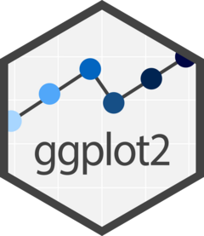
Formatting
ggplot(data = ____, mapping = aes(x = ____, y = ____, …)) +
geom_*insert plot name*()
Types of ggplot plots: geom_hist, geom_ point, geom_smooth, geom_boxplot, geom_hex, geom_bar, etc.
Mapping = determines an aspect of your plot with respect to another variable (usually preferred to put this in the ggplot() section vs. the geom section
Setting = determines an aspect of your plot based on a value you choose
Can customize lots of things such as fill, size, binwidth, color, linetype, etc.
Things to keep in mind!
Can use “viridis” and other similar color maps in R to make a visualization look pretty and functional (viridis is especially nice because the colors are chosen to be easily visible for those with colorblindness)
mapping usually goes in the ggplot parentheses while the setting goes in the geom_*plot name*() parentheses

Slide 24
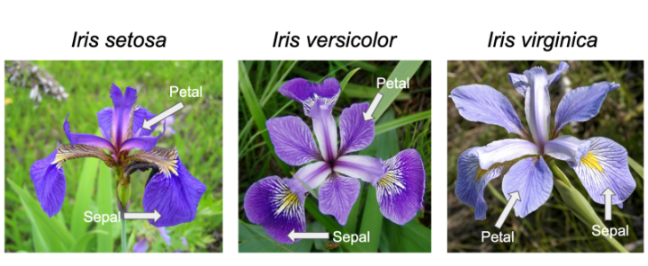
ggplot exercise # 1
Using the iris data set, create a histogram of the sepal.width variable with the color of the bins being red.

Slide 25
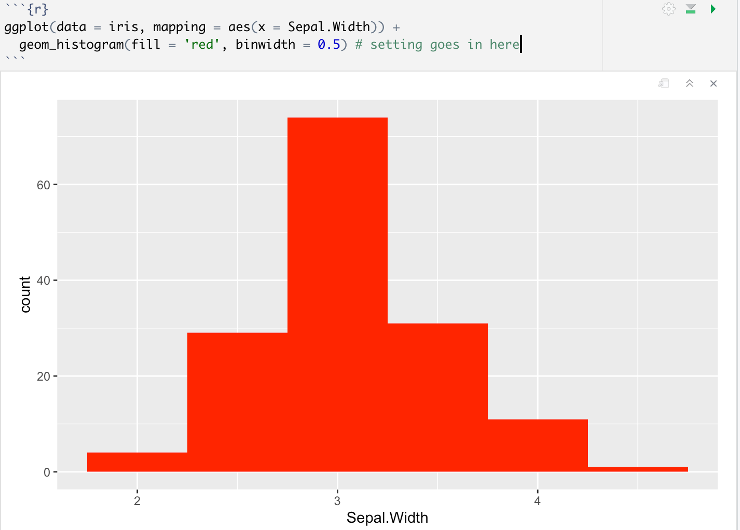
ggplot exercise answers (#1)

Slide 26
ggplot exercise # 2
Create a scatterplot of sepal.width vs. sepal.length with the color determined by petal.length.

Slide 27
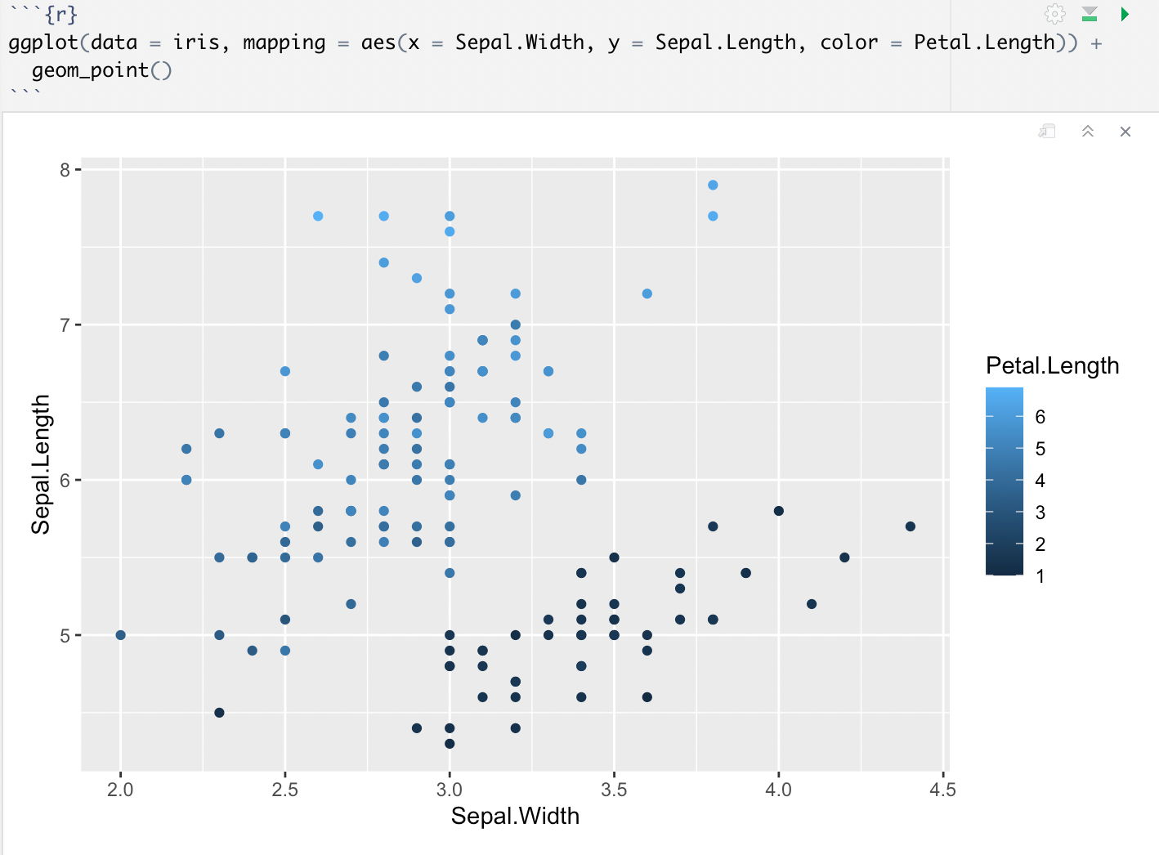
ggplot exercise answers (#2)

Slide 28
Matplotlib in Python
Matplotlib is a library for creating static, animated, and interactive visualizations in Python
Change runtime type to Python3
import matplotlib
Most of the Matplotlib utilities lies under the pyplot submodule, and are usually imported under the plt alias:
import matplotlib.pyplot as plt

Slide 29
Basic syntax/reminders!
Need separate lines to graph instead of including everything in parentheses like in ggplot:
plt.plot() ⬅ bare necessity #1
plt.xlabel()
plt.ylabel()
plt.title()
plt.show() ⬅ bare necessity #2
Google colab shows the graph without it but remember that in other places you have to use plt.show() for your visualization to display!!!

Slide 30
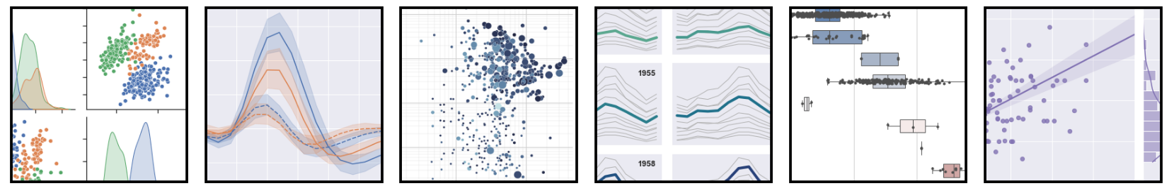
Seaborn in Python
Built on matplotlib
Good at handling pandas dataframes
More “beautiful” plots by default
Has functions for statistical plotting

Slide 31
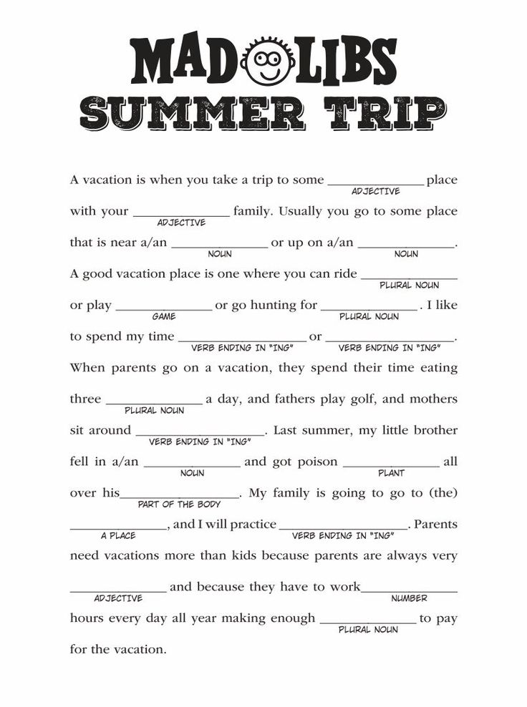
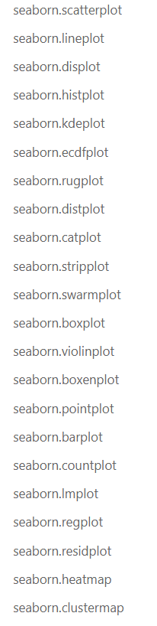
Seaborn makes it as easy as filling in the blanks!
There’s many plotting functions to choose from

Slide 32
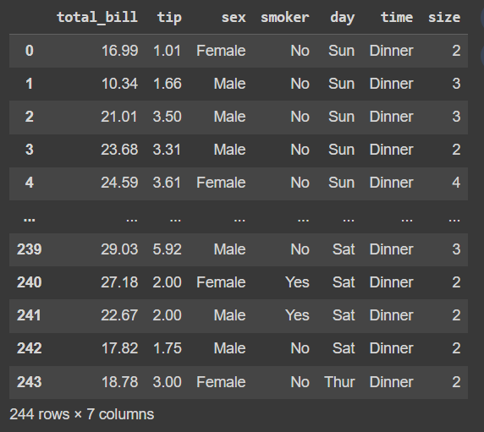
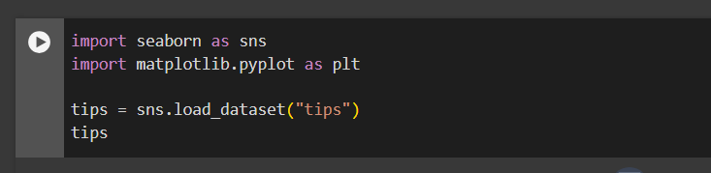
Let’s work with the “tips” dataset

Slide 33
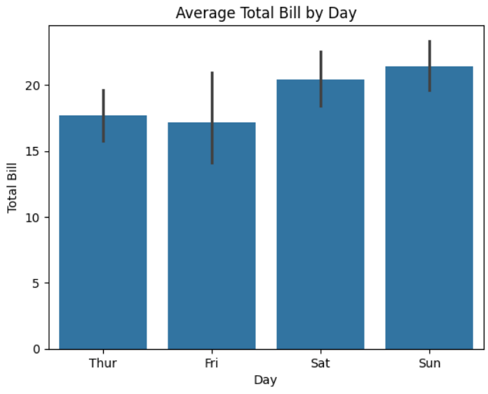
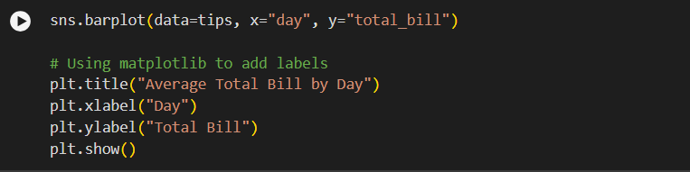
To make a simple barplot

Slide 34
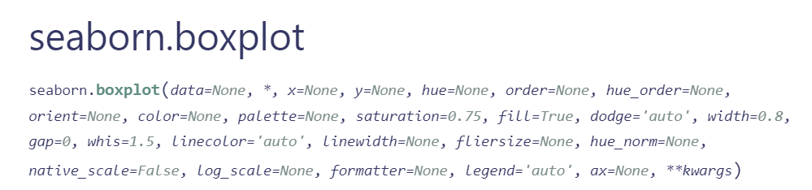
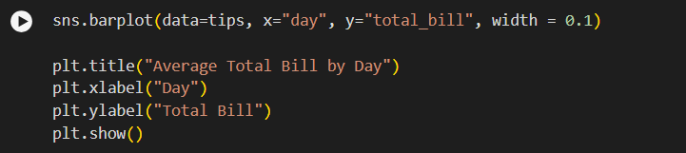

Slide 35
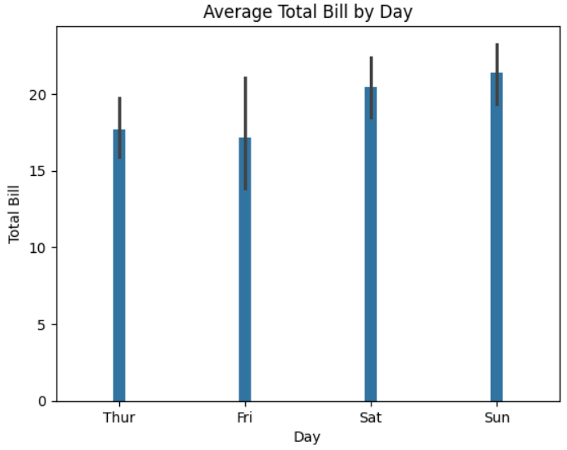
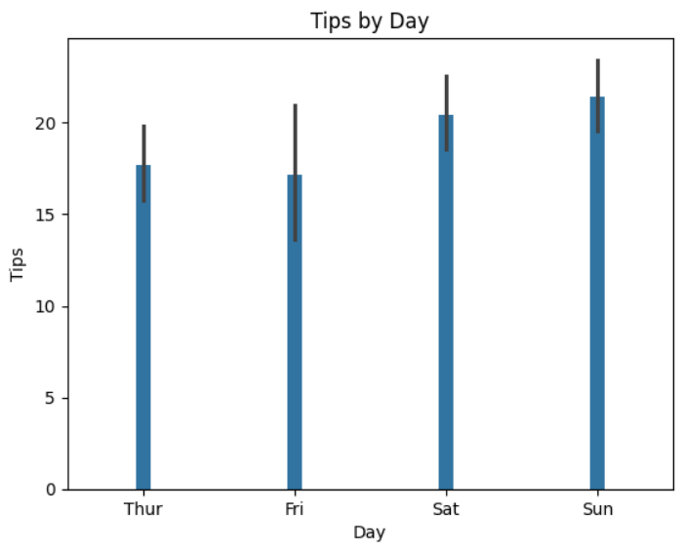

Slide 36
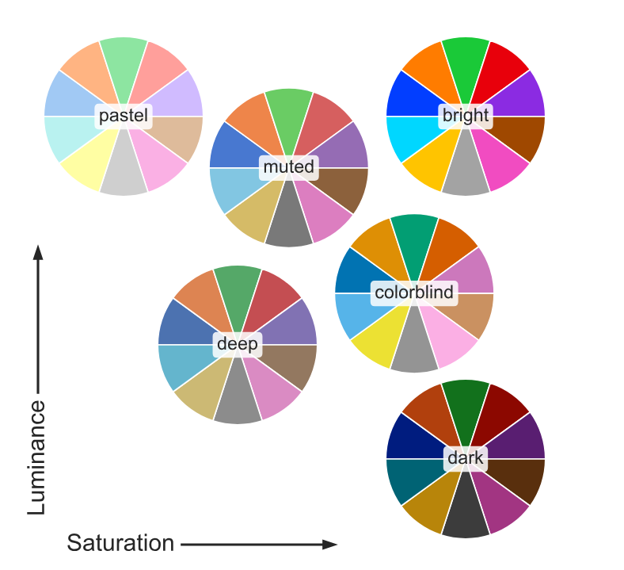
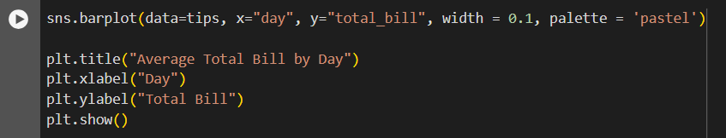

Slide 37
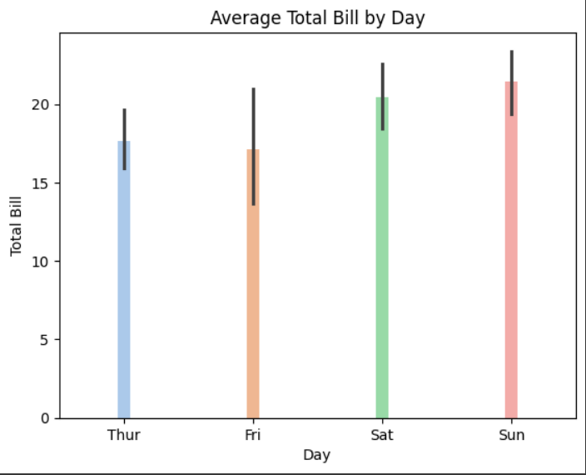
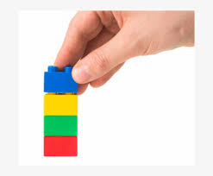

Slide 38
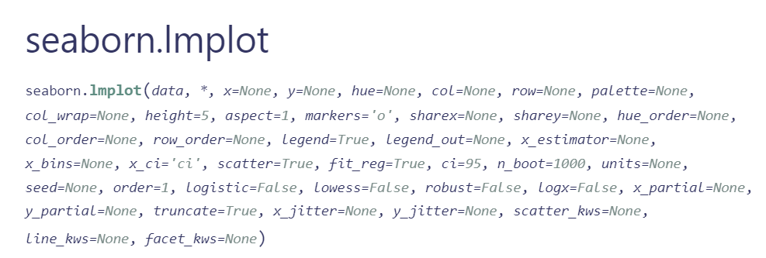
Your turn!
Let’s try a linear regression model (lmplot) between the total bill and the amount of tips
What can we say about this relationship? Does this make sense?
Make it your own, play with the parameters, don’t forget the labels :)

Slide 39
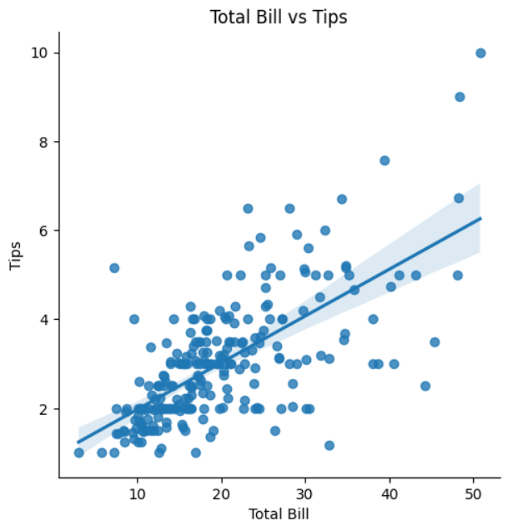
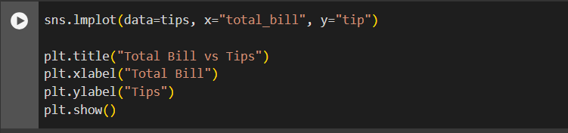
Yours better not be as boring as mine
There is a positive relationship!
The larger the bill, the larger the tip

Slide 40
Resources!
Data Visualization examples - https://informationisbeautiful.net/
Color palettes - https://colorbrewer2.org/#
Matplotlib tutorial - https://matplotlib.org/stable/tutorials/index.html
Seaborn tutorial - https://www.datacamp.com/tutorial/seaborn-python-tutorial
ggplot tutorial - https://r-statistics.co/Complete-Ggplot2-Tutorial-Part1-With-R-Code.html

Slide 41


Thank you!
IG: @data.ucd
FB: facebook.com/data.ucd
Website: davisdsc.com
GitHub: Davis-Data-Science-Club
Discord: discord.gg/zCPRKHdM7
Linktree: linktr.ee/davisdsc
Notes:
QR code in case ppl need to sign in
https://linktr.ee/davisdsc
https://discord.gg/zCPRKHdM7
www.davisdsc.com
www.facebook.com/data.ucd

